Slide 1



Multivariate Time-Series Prediction Using Deep Learning
Navashanthan Thavachchelvam
Date: 2025.04.21

Slide 2
CONTENTS
1. Introduction
2. Data Insights
3. Preprocessing
4. Feature Engineering
5. Model Design
6. Results
7. Model Optimization
8. Challenges and Solutions
9. Conclusion

Slide 3

01
Introduction

Slide 4

Introduction
The primary aim of this project is to create a capable deep learning model for accurately forecasting future stock closing prices based on historical data from the NASDAQ exchange.
The utilized dataset encompasses daily stock performance metrics including Open, High, Low, Close, Adjusted Close, and Volume.
One of the main challenges is the preprocessing of extensive multivariate time-series data, which includes feature engineering and designing a predictive model that can effectively capture the temporal dependencies present in the data.
This forecasting capability is essential for quantitative researchers and financial analysts as it aids in identifying trends and making well-informed investment decisions.
Our model is designed to enhance baseline predictions by utilizing advanced deep learning architectures such as Long Short-Term Memory (LSTM) , Gated Recurrent Unit (GRU) models and CNN-LSTM

Slide 5

02
Data Insights

Slide 6



Dataset Overview
Null Values: The dataset is complete; no missing values were detected.
2
Dataset Shape: Contains 2577 rows and 7 columns, providing ample information for thorough analysis.
1
3
Duplicate Entries: The integrity of the data is verified as no duplicated rows were found.

Slide 7

Summary Statistics
Key features were analyzed for their mean, median, standard deviation, and distribution characteristics to understand their overall behavior.

Slide 8





Insights from Visualizations
Correlation Heatmap: Highlighted strong positive relationships between key variables, which aids in feature selection for the modeling process.
Boxplots: Identified and visualized outliers in specific features before implementing capping methods.
1
2
Displot: Revealed outliers, skewness, and the overall distribution shape, improving data interpretation by visualizing the count and spread of usage across all features.
Line Chart: Demonstrated trends in appliance usage over time, allowing for the identification of patterns and fluctuations that are beneficial for forecasting and analysis.
4
3

Slide 9

03
Preprocessing

Slide 10

Handling Null Values
We evaluated each column for missing values; however, the dataset contained no missing entries throughout.

Slide 11

Data Cleaning
The next step involved ensuring that the dataset was complete and consistent. We searched for duplicate rows to prevent redundancy and confirmed that no duplicates were present.

Slide 12




Outliers Detection and Treatment
Several independent features exhibited outliers. To diminish their impact on model performance, capping methods were used.
For the Volume column, outlier detection employed the Interquartile Range (IQR) method to successfully cap extreme values.
1
2

Slide 13

Feature Scaling
Min-Max Scaling was chosen for feature scaling, transforming the features into a fixed range of 0 to 1. This method is particularly suitable for the dataset as it ensures all features are uniform in scale, thus preventing any single feature from disproportionately influencing the learning process.

Slide 14

04
Feature Engineering

Slide 15





Features Created and Selected/Time-Based Features
Day of the Week (DayOfWeek)
Extracted key date components:
2
1
3
Month
Created a binary feature, IsHoliday, by referencing the U.S. Federal Holiday Calendar to explain variations in trading volumes or prices.
5
4
Quarter

Slide 16


Features Created and Selected/Lagged Features
Visualized autocorrelation of the Close price:
1-day lag feature (Close_t-1)
5-day lag feature (Close_t-5)
10-day lag feature (Close_t-10)

Slide 17





Features Created and Selected/Statistical Rolling Features
2
Mean (rolling_mean)
Computed rolling statistics over windows of 3, 6, and 9 days:
1
3
Standard deviation (rolling_std)
5
Maximum (rolling_max)
4
Minimum (rolling_min)

Slide 18





Features Created and Selected/Interaction Features
2
Engineered features include:
Created Volatility, calculated as the range: High - Low.
1
3
Volume_x_Volatility
5
Range_x_Volume
4
Close_x_Volume

Slide 19


Handling Null Values
Newly implemented features resulted in null values, which were drop due to the features' nature.
The remove null was selected Since most nulls are due to rolling/shift, best to drop initial rows its ability to better preserve the distribution.

Slide 20







Feature Selection/Methods Used(1)
RFE Selected Features: ['Close_t-1', 'High', 'Low', 'Open', 'SP500_dummy', 'rolling_max_3', 'rolling_mean_3', 'rolling_min_3', 'rolling_min_6']
High correlation features were found and eliminated to reduce multicollinearity, assisting in the prevention of overfitting.
Random Forest was utilized to recursively assess and remove less significant features.
Selected features included: ['Close_vs_SP500', 'DayOfWeek', 'IsHoliday', 'Quarter', 'Volume', 'Volume_x_Volatility']
Correlation Analysis:
Recursive Feature Elimination (RFE):
3
4
2
5
1
6

Slide 21



Feature Selection/Methods Used(2)
Random Forest enabled the calculation of feature importance, retaining significant predictors for the model.
Selected features: ['Low', 'High', 'rolling_min_3', 'rolling_mean_3', 'SP500_dummy']
Tree-Based Importance:
2
1
3

Slide 22

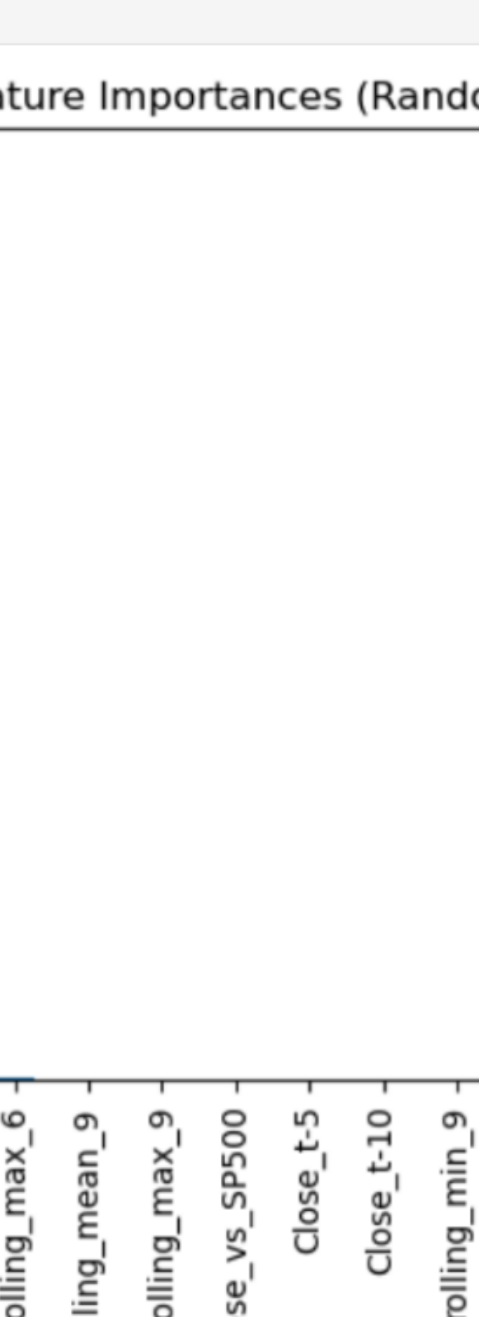
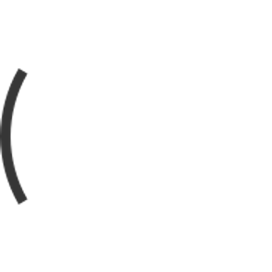


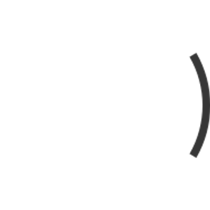


Feature Selection/Final Feature Selection(1)
Features included:
'Close_t-1',
'rolling_mean_3',
'rolling_min_3',
'rolling_std_3',
'Volume',
'Close_vs_SP500',
'Volume_x_Volatility',
'DayOfWeek',
'IsHoliday'.
A merger of features from the three methodologies generated the final feature set:
1
2
6
3
5
4
'rolling_std_3',
'Close_t-1',
'rolling_min_3',
'rolling_mean_3',

Slide 23
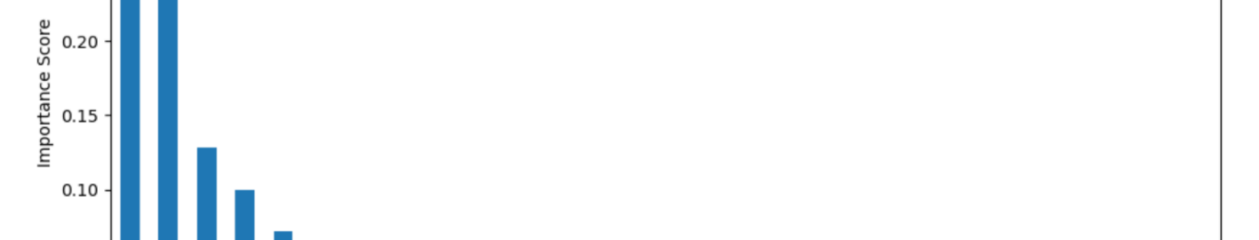

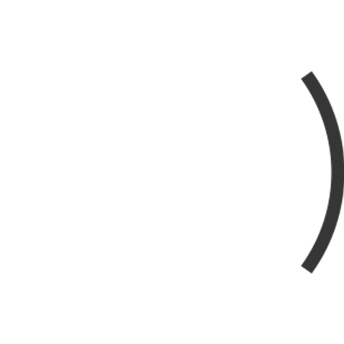



Feature Selection/Final Feature Selection(2)
2
'Close_vs_SP500',
1
'Volume',
3
'Volume_x_Volatility',
'IsHoliday'.
5
'DayOfWeek',
4

Slide 24
Feature Selection/Final Feature Selection(1)
'Close_t-1',
'rolling_mean_3',
'rolling_min_3',
'rolling_std_3',
'Volume',
'Close_vs_SP500',

Slide 25
Feature Selection/Final Feature Selection(2)
'Volume_x_Volatility',
'DayOfWeek',
'IsHoliday'.

Slide 26


Feature Selection/Scaling of Newly Created Features
1
New columns required scaling, specifically those that exhibited varied scales that could hamper model performance.
2
Standardization (Z-score scaling) was utilized, converting attributes to have a mean of 0 and standard deviation of 1. This strategy assures accelerated training of deep learning models.

Slide 27

05
Model Design

Slide 28

Baseline Models/Linear Regression Model
This straightforward approach assesses linear connections between independent variables and the target variable, with performance gauged using Mean Squared Error (MSE) and R-squared (R²) metrics.

Slide 29


Baseline Models/Random Forest Regressor
This ensemble methodology captures complex relationships in the data, accommodating mixed data types and yielding robust performance.
Evaluated based on MSE and R² scores for comparative insights with deep learning models.
1
2

Slide 30







Deep Learning Models/LSTM (Long Short-Term Memory) Model(1)
Architecture:
LSTM Layer (64 units) along with Dropout (0.2) to prevent overfitting.
A second LSTM Layer (32 units) enhances precision in temporal pattern capture.
Dense Layer (16 units) refines extracted features, followed by an Output Layer predicting energy consumption.
Renowned for capturing long-term relationships in sequential data, essential for forecasting energy consumption patterns.
1
2
6
3
5
4
Activation Functions: Tanh for LSTM layers; ReLU for the dense layer.
LSTM Layer (64 units) along with Dropout (0.2) to prevent overfitting.
Dense Layer (16 units) refines extracted features, followed by an Output Layer predicting energy consumption.
A second LSTM Layer (32 units) enhances precision in temporal pattern capture.

Slide 31


Deep Learning Models/LSTM (Long Short-Term Memory) Model(2)
1
Optimizer: Adam for adaptable learning rate.
Loss Function: Mean Squared Error (MSE).
2

Slide 32



Deep Learning Models/LSTM (Long Short-Term Memory) Model
LSTM Layer (64 units) along with Dropout (0.2) to prevent overfitting.
A second LSTM Layer (32 units) enhances precision in temporal pattern capture.
Dense Layer (16 units) refines extracted features, followed by an Output Layer predicting energy consumption.

Slide 33





Deep Learning Models/GRU (Gated Recurrent Unit) Model
A simpler recurrent model effectively addressing sequential dependencies, chosen for comparative performance evaluation.
Architecture: Similar to LSTM but utilizes GRU layers for efficiency.
Activation Functions: Tanh in GRU layers; ReLU in the dense layer.
Optimizer: Adam for robust performance metrics.
2
3
1
4

Slide 34




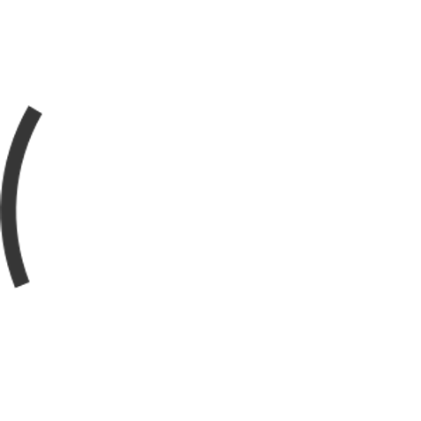



Deep Learning Models/CNN-LSTM Model
Architecture:
1D Convolutional Layer extracts local trends.
MaxPooling1D reduces dimensionality.
LSTM Layer (64 units) captures longer-term dependencies, followed by Dropout (0.2) and an Output Layer for predicted values.
Integrates CNN layers for local pattern extraction before processing through LSTM layers for long-term dependencies.
2
1
3
7
4
1D Convolutional Layer extracts local trends.
Optimizer: Adam for effective training.
6
5
MaxPooling1D reduces dimensionality.
Activation Functions: ReLU in the convolutional layer and Tanh in the LSTM layer.
LSTM Layer (64 units) captures longer-term dependencies, followed by Dropout (0.2) and an Output Layer for predicted values.

Slide 35

Deep Learning Models/CNN-LSTM Model
1D Convolutional Layer extracts local trends.
MaxPooling1D reduces dimensionality.
LSTM Layer (64 units) captures longer-term dependencies, followed by Dropout (0.2) and an Output Layer for predicted values.

Slide 36

06
Results

Slide 37
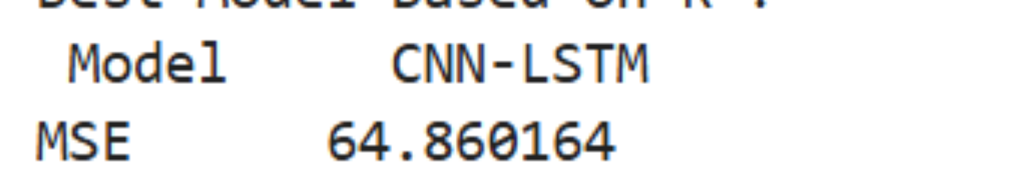
Results
Plot the evaluation metrics MSE and R² separately

Slide 38
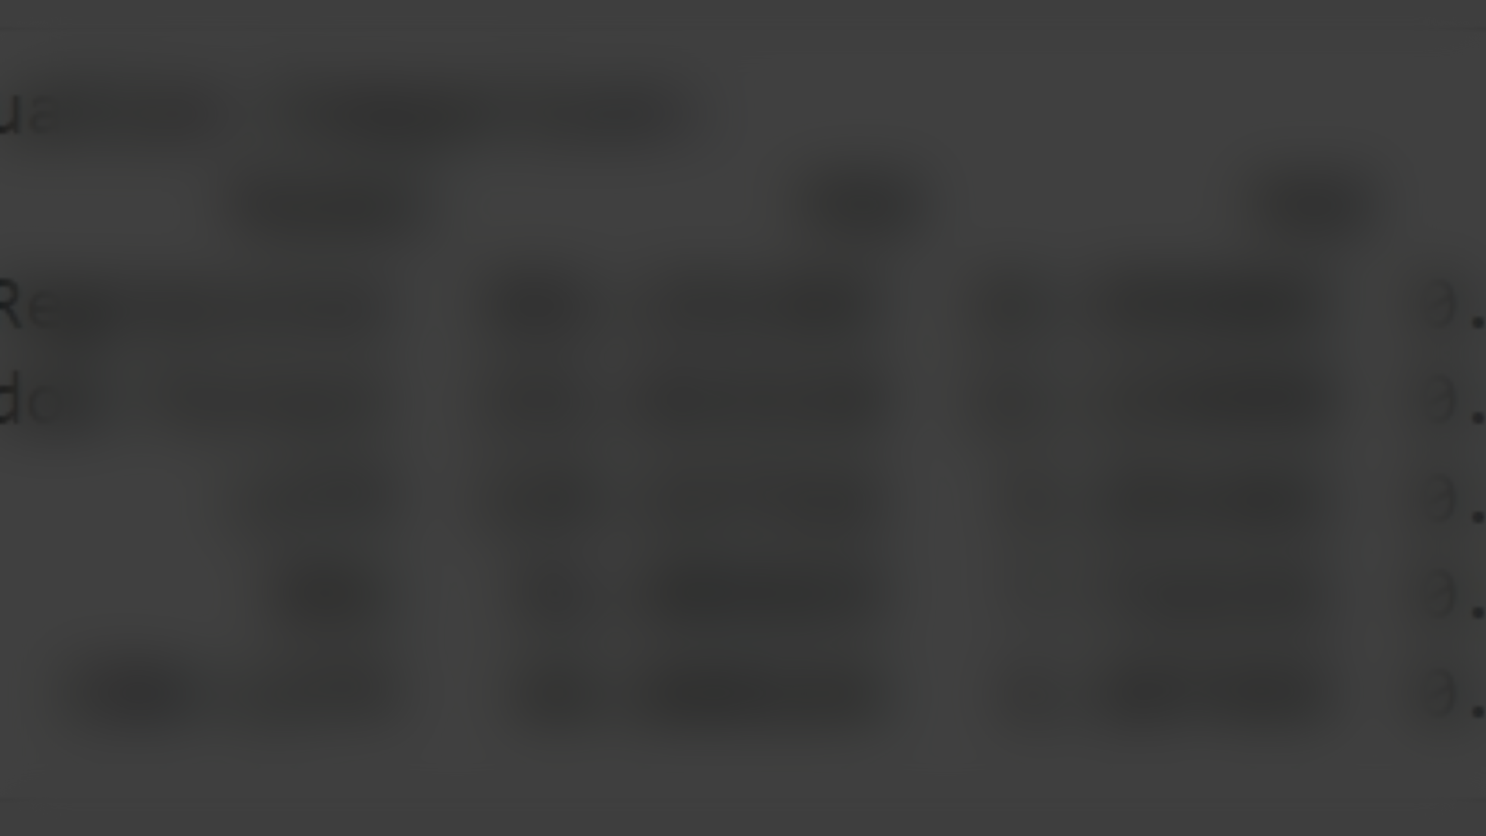
Evaluation Metrics Comparison
Utilized Mean Squared Error (MSE) and R-squared (R²) for performance evaluation, concluding that while the Random Forest model obtained an R² score of 0.975875, the CNN-LSTM model surpassed it with an R² score of 0.993250 and a lower MSE, showcasing its predictive superiority.

Slide 39
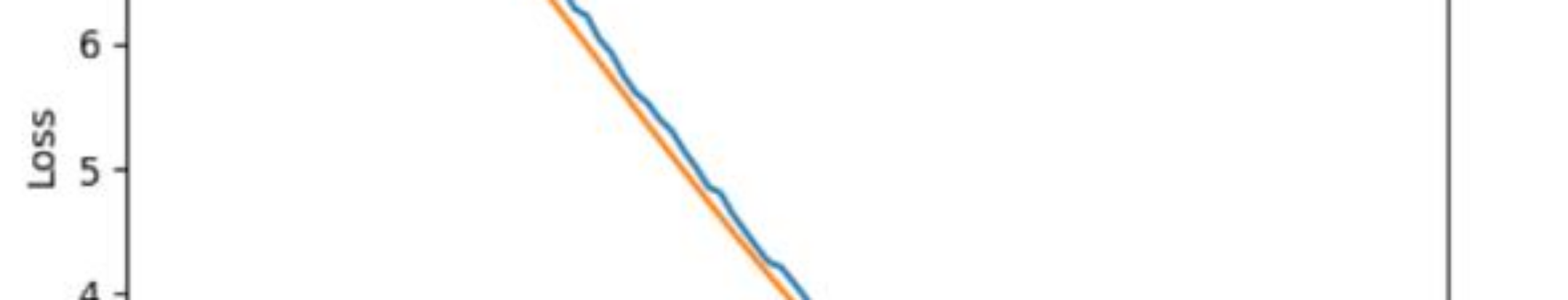
Training History Plots
Created plots for training history displaying Loss (MSE) throughout training and validation phases, illustrating model learning dynamics.

Slide 40
Predicted vs. Actual Values
Generated plots to visually compare predicted values against actual outcomes for evaluation purposes.

Slide 41
Residual Plots
Residual plots help check error distributions and identify potential patterns, essential for model diagnostics.

Slide 42
07
Model Optimization

Slide 43
Hyperparameter Tuning
Implemented a grid search to optimize parameters including units in LSTM layers, dropout rates, learning rates, epochs, and batch sizes for testing model configurations, ultimately using MSE as the evaluation criterion.

Slide 44

Early Stopping
An Early Stopping callback was utilized to monitor validation loss, ceasing training when no improvement was noted, thus conserving resources and aiding in model performance stabilization.

Slide 45

08
Challenges and Solutions

Slide 46


Challenges and Solutions
Technical Challenges | Solutions
Handling Missing Values | Used median imputation for filling in missing values to ensure data integrity.
Outliers in the Data | Applied IQR and Z-scores to detect and manage extreme outliers for improved reliability.
Feature Selection and Dimensionality | Utilized RFE and correlation analysis to minimize irrelevant features enhancing interpretability.
Model Hyperparameter Tuning | Conducted grid search and manual adjustments for optimized hyperparameters improving overall performance.
Model Evaluation | Compared baseline models against deep learning frameworks to ensure top-tier predictive accuracy.

Slide 47

09
Conclusion

Slide 48



Conclusion
Effective feature engineering played a vital role in model performance through the creation of lagged, rolling statistics, and interaction features.
2
Deep learning frameworks, particularly LSTM, demonstrated enhanced predictive accuracy over traditional models.
1
Future enhancements may derive from incorporating sector performance, employing transformer-based models, and extending capabilities to multi-stock predictions.
3

Slide 49
Thank You

